Slide 1
18EES101J
BASIC ELECTRICAL & ELECTRONICS ENGINEERING

Slide 2
HOUR | TOPICS TO BE COVERED
UNIT 1 ELECTRICAL CIRCUITS
1 | Introduction to DC and AC circuits. Active and Passive two terminal elements
2 | Ohms law, Voltage-Current relation, Power, Energy, R,L,C Circuits, Voltage and Current Sources
3 | Kirchoff’s current law. Kirchoff's Voltage Law
4 | Problem Solving Session,
5 | Mesh Current Analysis, Nodal Voltage Analysis
6 | Thevenin’s Theorem, Norton’s Theorem
7 | Maximum Power Transfer Theorem, Star- Delta Transformation
8 | Problem Solving Session
9 | Resistive Circuit Analysis, Superposition, Convolution
10 | RL Circuit Transient Analysis, RC & RLC Transient Analysis
11 | Three Phase Systems, Connections, Relation between Line and Phase
12 | Problem Solving Session

Slide 3
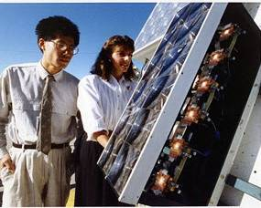
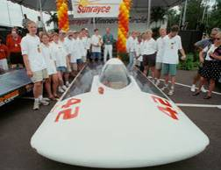


Electricity
Movement of electrons
Invisible force that provides
light, heat, sound, motion . . .

Slide 4


Components of an Atom
Electricity at the Atomic Level
Nucleus
The center portion of an atom containing the protons and neutrons
Protons
Positively charged atomic particles
Neutrons
Uncharged atomic particles

Slide 5
Atomic Number
Electricity at the Atomic Level
The atomic number is equal to the number of protons in the nucleus of an atom.
The atomic number identifies the element.

Slide 6
Electrons
Electricity at the Atomic Level
Negatively charged particles
Electron Orbitals
Orbits in which electrons move around the nucleus of an atom
Valence Electrons
The outermost ring of electrons in an atom
2D
3D
Notes:
Electron

Slide 7

Electron Orbits
Electricity at the Atomic Level
Orbit Number | Maximum Electrons
1 | 2
2
3
4
5
6
Valence Orbit
2
8
18
32
50
72
8
Orbits closest to the nucleus fill first
Notes:
The outside, or valence orbit, never has more than 8 electrons.

Slide 8
Electron Orbits
Electricity at the Atomic Level
Atoms like to have their valence ring either filled (8) or empty(0) of electrons.
Copper
Cu
29
How many electrons are in the valence orbit?
1
Is copper a conductor or insulator?
Conductor
Why?

Slide 9
Electron Orbits
Electricity at the Atomic Level
Sulfur
S
16
How many electrons are in the valence orbit?
6
Is Sulfur a conductor or insulator?
Insulator
Why?

Slide 10
Electron Flow
Electricity at the Atomic Level
An electron from one orbit can knock out an electron from another orbit.
When an atom loses an electron, it seeks another to fill the vacancy.
Copper
Cu
29

Slide 11
Electron Flow
Electricity at the Atomic Level
Electricity is created as electrons collide and transfer from atom to atom.
Play Animation

Slide 12
Conductors and Insulators
Conductors | Insulators
Electrons flow easily between atoms
1-3 valence electrons in outer orbit
Examples: Silver, Copper, Gold, Aluminum
Electron flow is difficult between atoms
5-8 valence electrons in outer orbit
Examples: Mica, Glass, Quartz

Slide 13

Conductors and Insulators
Identify conductors and insulators
Insulators
Conductors

Slide 14
Electrical Circuit
A system of conductors and components forming a complete path for current to travel
Properties of an electrical circuit include
Voltage Volts V
Current Amps A
Resistance Ohms Ω

Slide 15
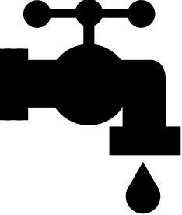
Current
The flow of electric charge
- measured in AMPERES (A)
Tank (Battery)
Faucet (Switch)
Pipe (Wiring)
When the faucet (switch) is off, is there any flow (current)?
NO
When the faucet (switch) is on, is there any flow (current)?
YES

Slide 16




Current in a Circuit
off
on
off
on
When the switch is off, there is no current.
When the switch is on, there is current.

Slide 17
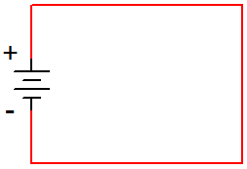
Current Flow
Conventional Current assumes that current flows out of the positive side of the battery, through the circuit, and back to the negative side of the battery. This was the convention established when electricity was first discovered, but it is incorrect!
Electron Flow is what actually happens. The electrons flow out of the negative side of the battery, through the circuit, and back to the positive side of the battery.
Conventional
Current
Electron
Flow
Notes:
Conventional Current vs. Electron Flow (Scientists vs. Engineers – since this is an engineering course, guess who wins?).
Circuit Theory Laws
Digital Electronics TM
1.2 Introduction to Analog
Project Lead The Way, Inc.
Copyright 2009

Slide 18
Engineering vs. Science
The direction that the current flows does not affect what the current is doing; thus, it doesn’t make any difference which convention is used as long as you are consistent.
Both Conventional Current and Electron Flow are used. In general, the science disciplines use Electron Flow, whereas the engineering disciplines use Conventional Current.
Since this is an engineering course, we will use Conventional Current .
Electron
Flow
Conventional
Current
Notes:
Of course, the engineers win!
Circuit Theory Laws
Digital Electronics TM
1.2 Introduction to Analog
Project Lead The Way, Inc.
Copyright 2009

Slide 19
Voltage
The force (pressure) that causes current to flow
- measured in VOLTS (V)
Tank (Battery)
Faucet (Switch)
Pipe (Wiring)
When the faucet (switch) is off, is there any pressure (voltage)?
YES – Pressure (voltage) is pushing against the pipe, tank, and the faucet.
When the faucet (switch) is on, is there any pressure (voltage)?
YES – Pressure (voltage) pushes flow (current) through the system.

Slide 20
Voltage in a Circuit
off
on
off
on
The battery provides voltage that will push current through the bulb when the switch is on.

Slide 21
Resistance
The opposition of current flow
- measured in Ohms (Ω)
Tank (Battery)
Faucet (Switch)
Pipe (Wiring)
What happens to the flow (current) if a rock gets lodged in the pipe?
Flow (current) decreases.
Notes:
All materials have resistance. Conductors have little resistance. Insulators provide a lot of resistance. Some electronic components (resistors) have a specific resistance. These are often needed to reduce current in order to protect other components or to adjust the amount of current that goes to other components.

Slide 22

Resistance in a Circuit
Resistor
off
on
Resistors are components that create resistance.
Reducing current causes the bulb to become more dim.

Slide 23
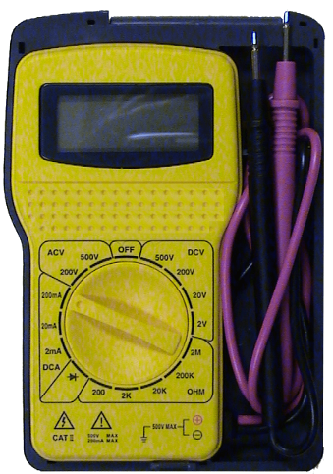
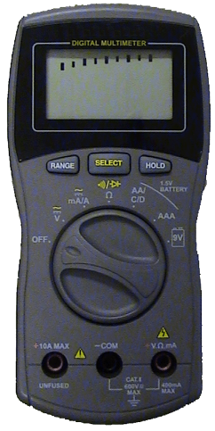
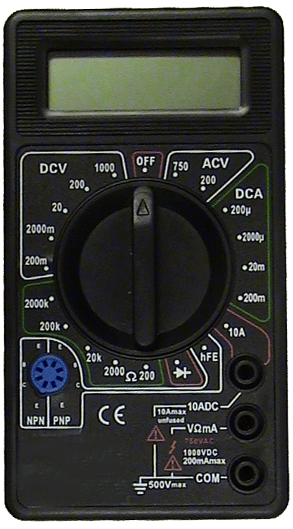
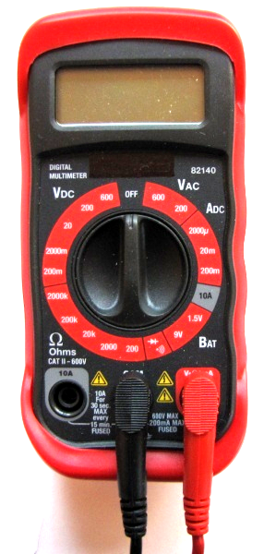
Multimeter
An instrument used to measure the properties of an electrical circuit, including
Voltage Volts
Current Amps
Resistance Ohms
Notes:
Sometimes the multimeter is referred to as the “Swiss Army Knife” of electricity.
Common measurements include continuity, voltage, current, and resistance. These are further discussed in this presentation and other presentations in this lesson.

Slide 24
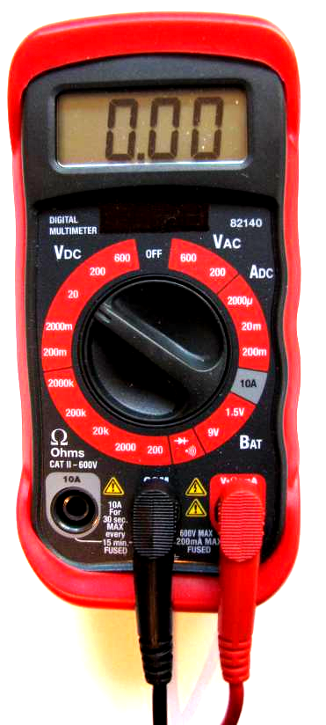
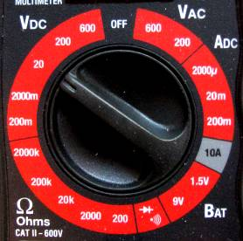
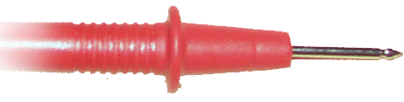
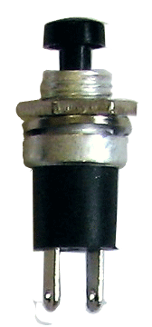
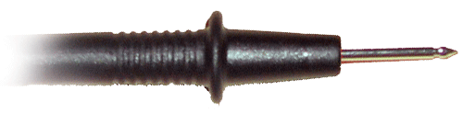


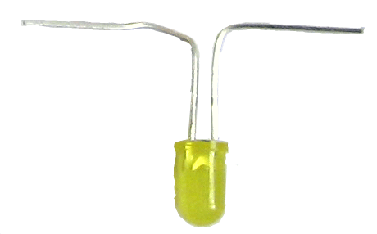
Measuring Voltage
Set multimeter to the proper V range.
Measure across a component.
Switch
Battery
Resistor
Light
Notes:
The positive and negative signs represent polarity and flow.
A digital multimeter will give a negative reading if the positive and negative terminals are reversed.
The voltage reading can be different between any measured component.

Slide 25
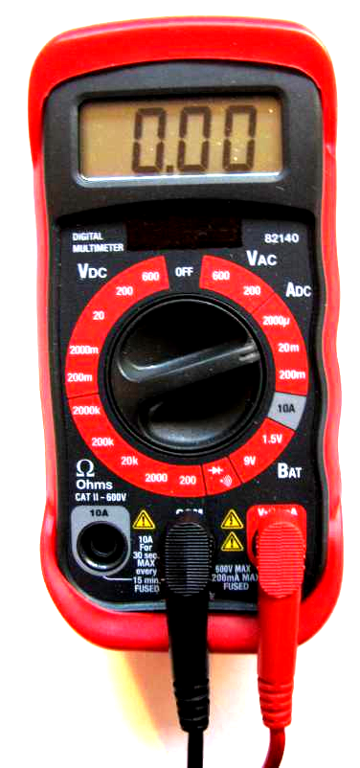
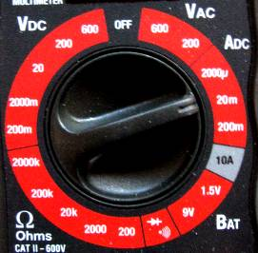
Measuring Current
Set multimeter to the proper ADC range.
Circuit flow must go through the meter.
Switch
Battery
Resistor
Light

Slide 26
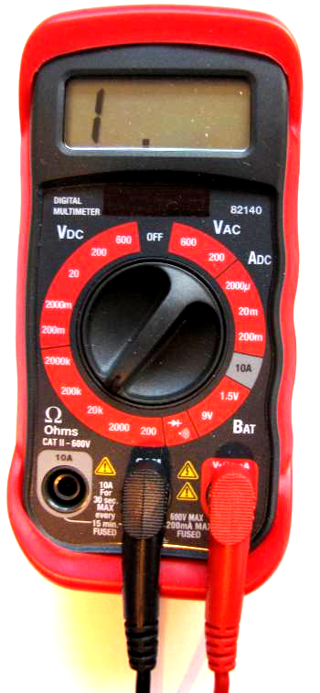
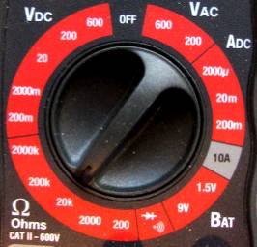
Measuring Resistance
Set multimeter to the proper Ohms range.
Measure across the component being tested.
Power must be off or removed from the circuit.
Switch
Battery
Resistor
Light

Slide 27
Ohm’s Law
Current in a resistor varies in direct proportion to the voltage applied to it and is inversely proportional to the resistor’s value
The mathematical relationship between current, voltage, and resistance
If you know 2 of the 3 quantities, you can solve for the third.
Quantities | Abbreviations | Units | Symbols
Voltage | V | Volts | V
Current | I | Amperes | A
Resistance | R | Ohms | Ω
V=IR
I=V/R
R=V/I

Slide 28


Ohm’s Law Chart
Cover the quantity that is unknown.
Solve for V
V
V=IR
I
R

Slide 29
Ohm’s Law Chart
Cover the quantity that is unknown.
Solve for I
V
I=V/R
I
R

Slide 30
Ohm’s Law Chart
Cover the quantity that is unknown.
Solve for R
V
R=V/I
I
R

Slide 31
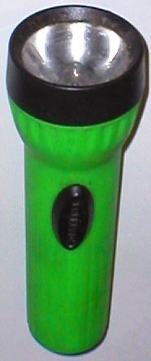
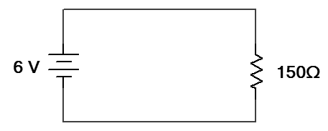

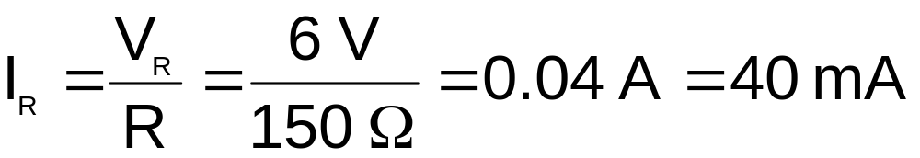
Example: Ohm’s Law
  The flashlight shown uses a 6 volt battery and has a bulb with a resistance of 150 Ω. When the flashlight is on, how much current will be drawn from the battery?
Schematic Diagram
I_{R}
V
+
-
V_{T} =
V_{R}
I
R
Notes:
Circuit Theory Laws
Digital Electronics TM
1.2 Introduction to Analog
Project Lead The Way, Inc.
Copyright 2009

Slide 32
Circuit Configuration
Components in a circuit can be connected in one of two ways.
Series Circuits
Components are connected end-to-end.
There is only a single path for current to flow.
Parallel Circuits
Both ends of the components are connected together.
There are multiple paths for current to flow.
Components
(i.e., resistors, batteries, capacitors, etc.)
Notes:
Overview of series and parallel component configuration.
Circuit Theory Laws
Digital Electronics TM
1.2 Introduction to Analog
Project Lead The Way, Inc.
Copyright 2009

Slide 33
Kirchhoff’s Laws
Kirchhoff’s Voltage Law (KVL):
  The sum of all of the voltage drops in a series circuit equals the total applied voltage
Kirchhoff’s Current Law (KCL):
  The total current in a parallel circuit equals the sum of the individual branch currents
Notes:
Circuit Theory Laws
Digital Electronics TM
1.2 Introduction to Analog
Project Lead The Way, Inc.
Copyright 2009

Slide 34
Series Circuits
A circuit that contains only one path for current flow
If the path is open anywhere in the circuit, current stops flowing to all components.

Slide 35
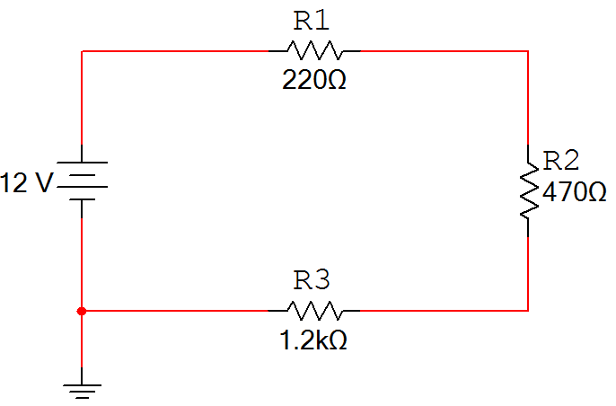
Series Circuits
Characteristics of a series circuit
The current flowing through every series component is equal.
The total resistance (R_{T}) is equal to the sum of all of the resistances (i.e., R₁ + R₂ + R₃).
The sum of all of the voltage drops (V_{R1} + V_{R2} + V_{R3}) is equal to the total applied voltage (V_{T}). This is called Kirchhoff’s Voltage Law.
V_{R1}
I_{T}
+
-
+
+
V_{T}
V_{R2}
-
-
R_{T}
-
+
V_{R3}
Notes:
Characteristics of a series circuit.
Circuit Theory Laws
Digital Electronics TM
1.2 Introduction to Analog
Project Lead The Way, Inc.
Copyright 2009

Slide 36
Example: Series Circuit
  For the series circuit shown, use the laws of circuit theory to calculate the following:
    The total resistance (R_{T})
    The current flowing through each component (I_{T}, I_{R1}, I_{R2}, & I_{R3})
    The voltage across each component (V_{T}, V_{R1}, V_{R2}, & V_{R3})
    Use the results to verify Kirchhoff’s Voltage Law.
V_{R1}
I_{T}
+
-
+
I_{R1}
+
V_{T}
I_{R2}
V_{R2}
-
I_{R3}
-
R_{T}
-
+
V_{R3}
Notes:
Pause the presentation and allow the student to work on the example. The solution is on the next three slides.
Circuit Theory Laws
Digital Electronics TM
1.2 Introduction to Analog
Project Lead The Way, Inc.
Copyright 2009

Slide 37
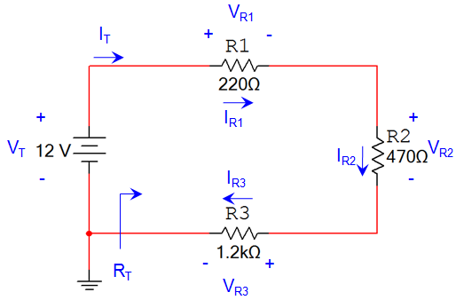



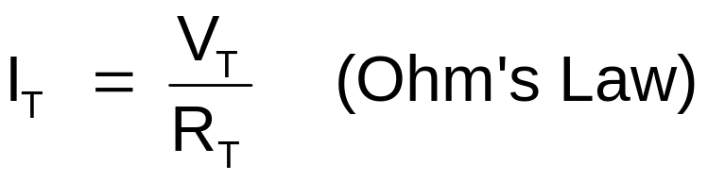
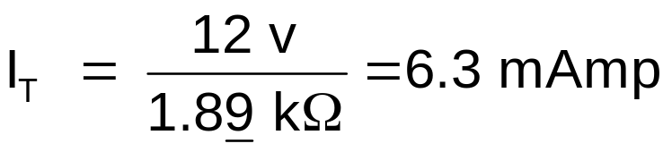
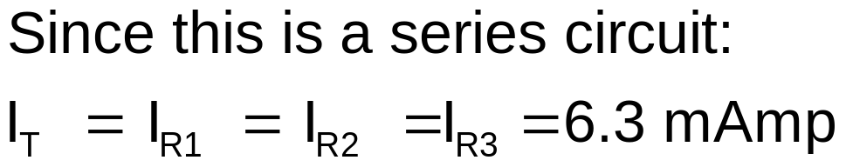
Example: Series Circuit
Solution:
Total Resistance:
Current Through Each Component:
V
I
R
Notes:
This slide provides the solution. If you print handouts, don’t print this page. (1 of 3)
Circuit Theory Laws
Digital Electronics TM
1.2 Introduction to Analog
Project Lead The Way, Inc.
Copyright 2009

Slide 38

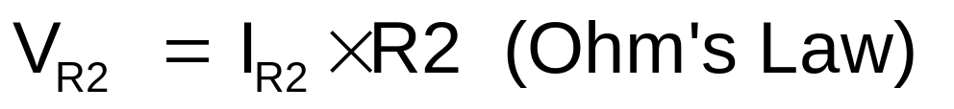
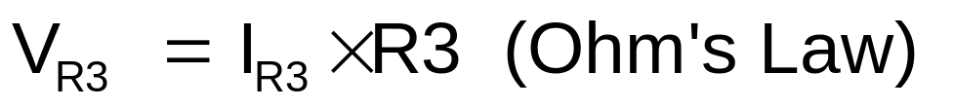
Example: Series Circuit
Solution:
Voltage Across Each Component:
V
I
R
Notes:
This slide provides the solution. If you print handouts, don’t print this page. (2 of 3)
Circuit Theory Laws
Digital Electronics TM
1.2 Introduction to Analog
Project Lead The Way, Inc.
Copyright 2009

Slide 39
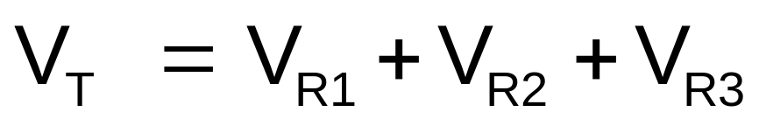

Example: Series Circuit
Solution:
Verify Kirchhoff’s Voltage Law:
Notes:
This slide provides the solution. If you print handouts, don’t print this page. (3 of 3)
Circuit Theory Laws
Digital Electronics TM
1.2 Introduction to Analog
Project Lead The Way, Inc.
Copyright 2009

Slide 40


Parallel Circuits
A circuit that contains more than one path for current flow
If a component is removed, then it is possible for the current to take another path to reach other components.

Slide 41
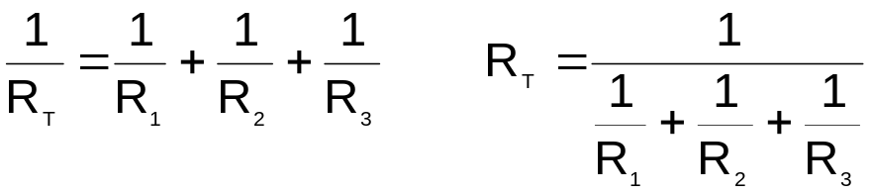
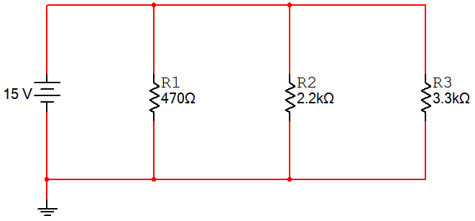
Parallel Circuits
Characteristics of a Parallel Circuit
The voltage across every parallel component is equal.
The total resistance (R_{T}) is equal to the reciprocal of the sum of the reciprocal:
The sum of all of the currents in each branch (I_{R1} + I_{R2} + I_{R3}) is equal to the total current (I_{T}). This is called Kirchhoff’s Current Law.
I_{T}
+
+
+
+
V_{T}
V_{R1}
V_{R2}
V_{R3}
-
-
-
-
R_{T}
Notes:
Characteristics of a parallel circuit.
Circuit Theory Laws
Digital Electronics TM
1.2 Introduction to Analog
Project Lead The Way, Inc.
Copyright 2009

Slide 42
Example Parallel Circuits
  For the parallel circuit shown, use the laws of circuit theory to calculate the following:
    The total resistance (R_{T})
    The voltage across each component (V_{T}, V_{R1}, V_{R2}, & V_{R3})
    The current flowing through each component (I_{T}, I_{R1}, I_{R2}, & I_{R3})
    Use the results to verify Kirchhoff’s Current Law.
I_{T}
I_{R1}
I_{R2}
I_{R3}
+
+
+
+
V_{T}
V_{R1}
V_{R2}
V_{R3}
-
-
-
-
R_{T}
Notes:
Pause the presentation and allow the student to work on the example. The solution is on the next three slides.
Circuit Theory Laws
Digital Electronics TM
1.2 Introduction to Analog
Project Lead The Way, Inc.
Copyright 2009

Slide 43
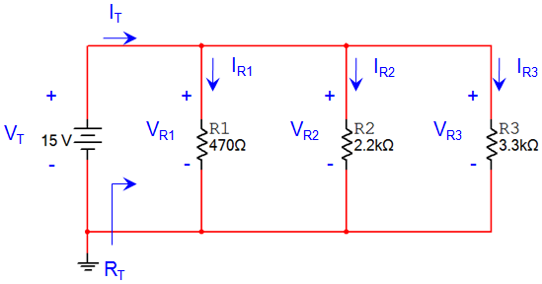
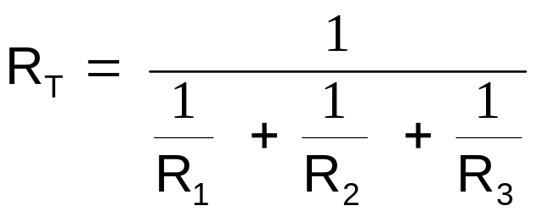
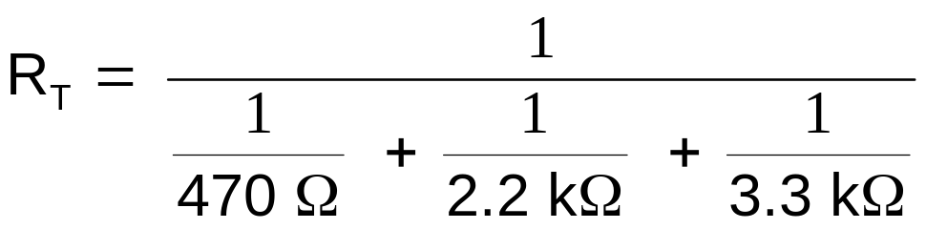

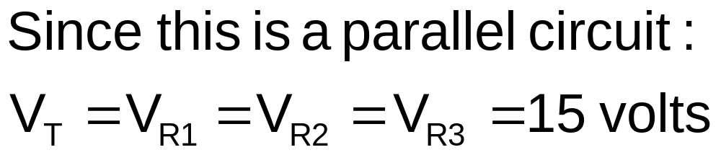
Example Parallel Circuits
Solution:
Total Resistance:
Voltage Across Each Component:
Notes:
This slide provides the solution. If you print handouts, don’t print this page. (1 of 3)
Circuit Theory Laws
Digital Electronics TM
1.2 Introduction to Analog
Project Lead The Way, Inc.
Copyright 2009

Slide 44
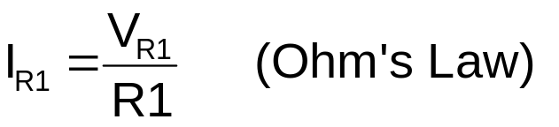
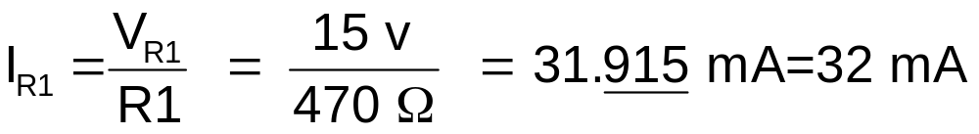
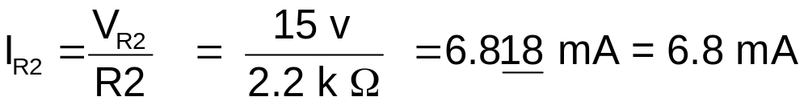
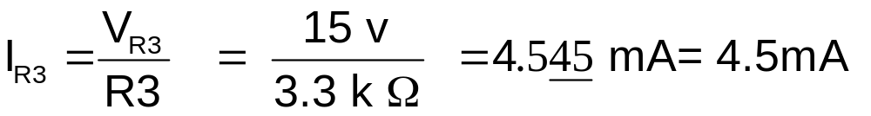
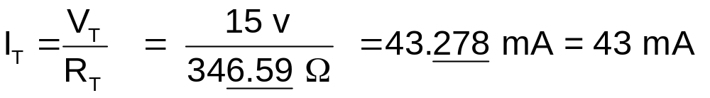
Example Parallel Circuits
Solution:
Current Through Each Component:
V
I
R
Notes:
This slide provides the solution. If you print handouts, don’t print this page. (2 of 3)
Circuit Theory Laws
Digital Electronics TM
1.2 Introduction to Analog
Project Lead The Way, Inc.
Copyright 2009

Slide 45
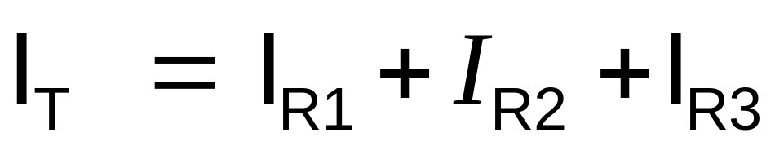
Example Parallel Circuits
Solution:
Verify Kirchhoff’s Current Law:
Notes:
This slide provides the solution. If you print handouts, don’t print this page. (3 of 3)
Circuit Theory Laws
Digital Electronics TM
1.2 Introduction to Analog
Project Lead The Way, Inc.
Copyright 2009

Slide 46


Combination Circuits
Contain both series and parallel arrangements
What would happen if you removed light 1? light 2? light 3?
1
2
3

Slide 47
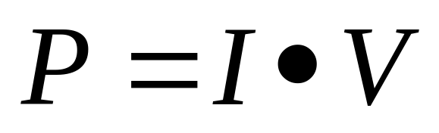
Electrical Power
Electrical power is directly related to the amount of current and voltage within a system.
Power is measured in watts

